Slide 1

ICT Learning Centre @ UL - Python and ML Foundations
Python - Conditionals

Slide 2


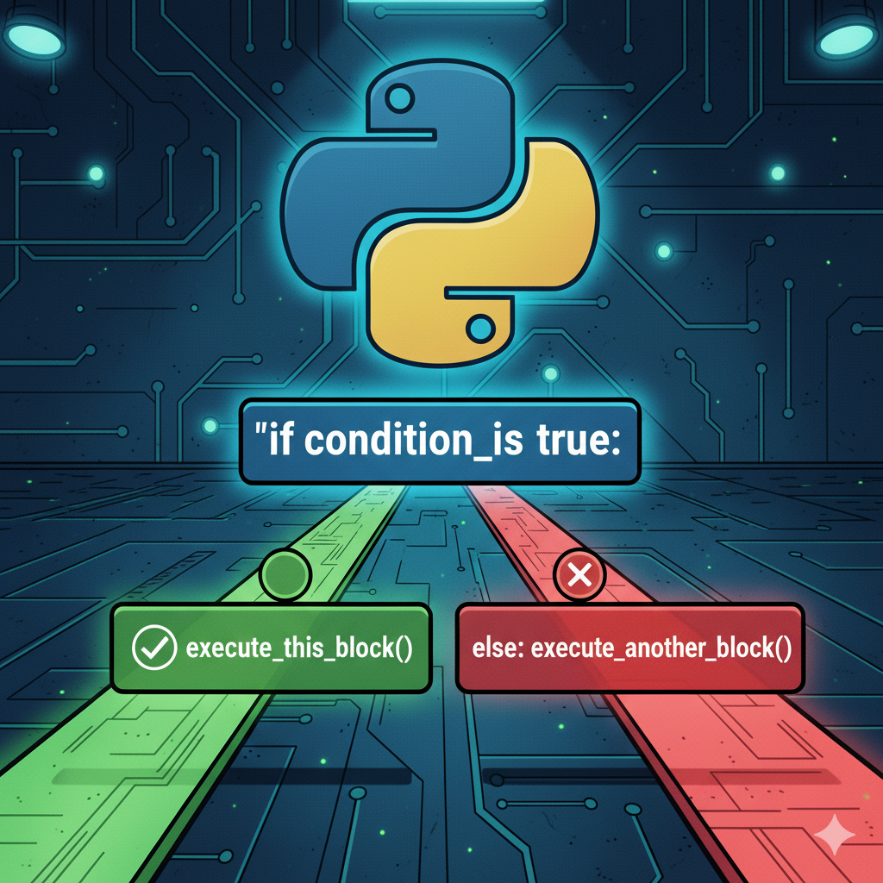
Conditionals
Control flow statements

Slide 3


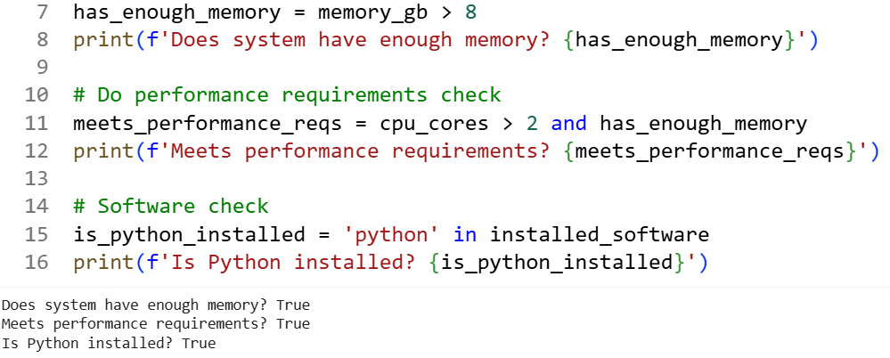
Recap
Boolean datatypes: True, False
Conditional operators: <, <=, >, >=, ==, !=
Logical operators: and, or, not
Membership operator: in

Slide 4
What are conditionals?
Conditional statements let your program make choices.
Control the ‘flow’ of your code.
Condition
True
False
Do something
Do something else

Slide 5
The if-else statement
For binary decisions i.e., either this or that
Condition
Condition
True
True
False
False
Do something
Do something else

Slide 6
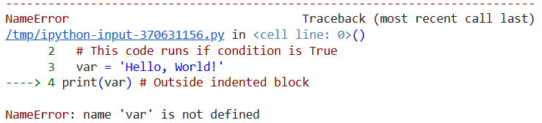
if-else statement syntax
if <CONDITION>
# This code runs if condition is True
:
var = ‘Hello, World!’
else:
# This code runs if condition is False
print(var) # Outside indented code block
Note:
Indentation is crucial!!!
else does not take a condition.

Slide 7
if-else statement example
if score >= 90.0:
print(‘Student has scored A1!’)
else:
print(‘Student has scored a grade below A1.’)

Slide 8
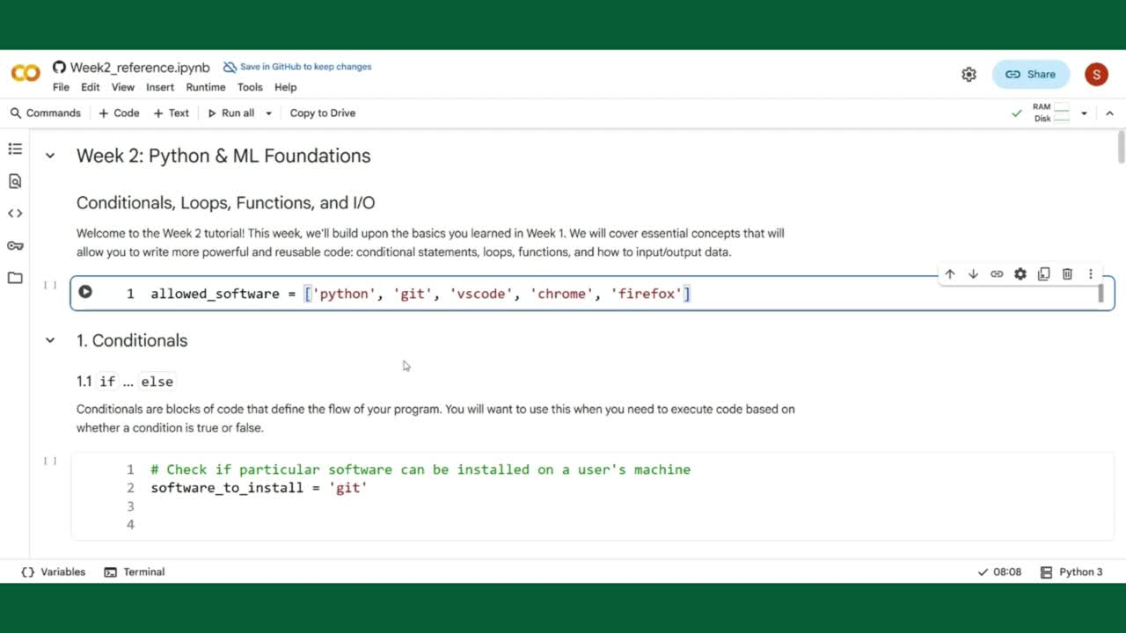

Slide 14
The elif statement
Short for “else if”.
Used to check for multiple conditions in sequence.
Condition 1
True
False
Do something
Condition 2
True
False
Do something
Do something else

Slide 15
elif statement syntax
if <CONDITION_1>:
# This code runs if condition 1 is True
elif <CONDITION_2>:
# This code runs if condition 1 is False but condition 2 is True
else:
# This code runs if all above conditions are false

Slide 16
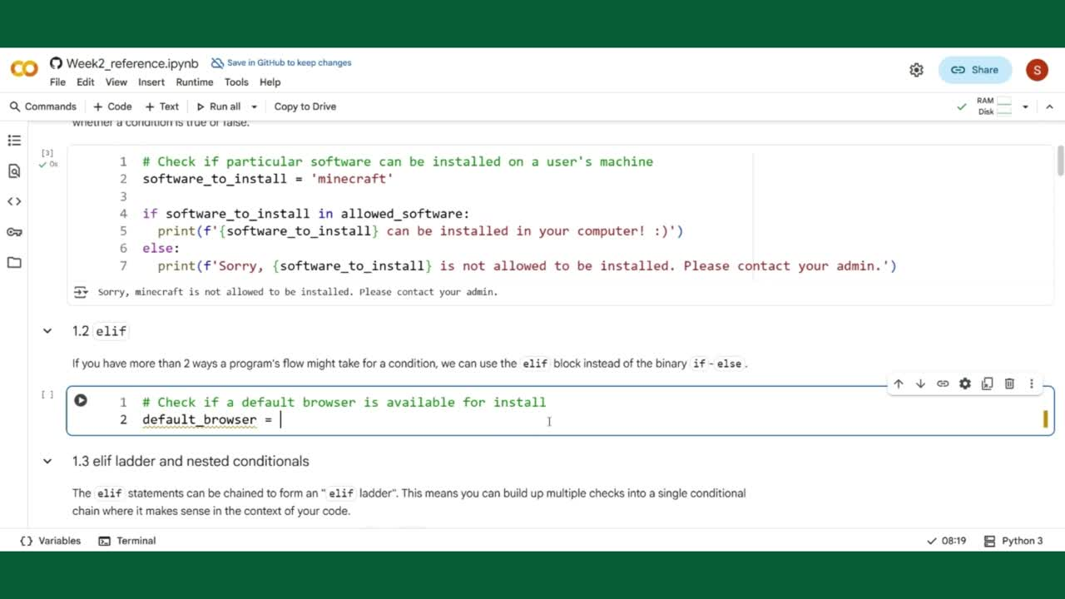

Slide 20
The elif ladder
The elif ladder
if <CONDITION_1>:
# This code runs if condition 1 is True
elif <CONDITION_2>:
# This code runs if condition 1 is False but condition 2 is True
.
.
.
elif <CONDITION_n>:
# This code runs if conditions 1 to n-1 is False but condition n is True
else:
# This code runs if all above conditions are false

Slide 21
Remember: Conditions can be chained
if <CONDITION_1> and <CONDITION_2>:
# This code runs if above expression evaluates to True
elif <CONDITION_3> or <CONDITION_4>:
# This code runs if above expression evaluates to True
else:
# This code runs if condition is False

Slide 22
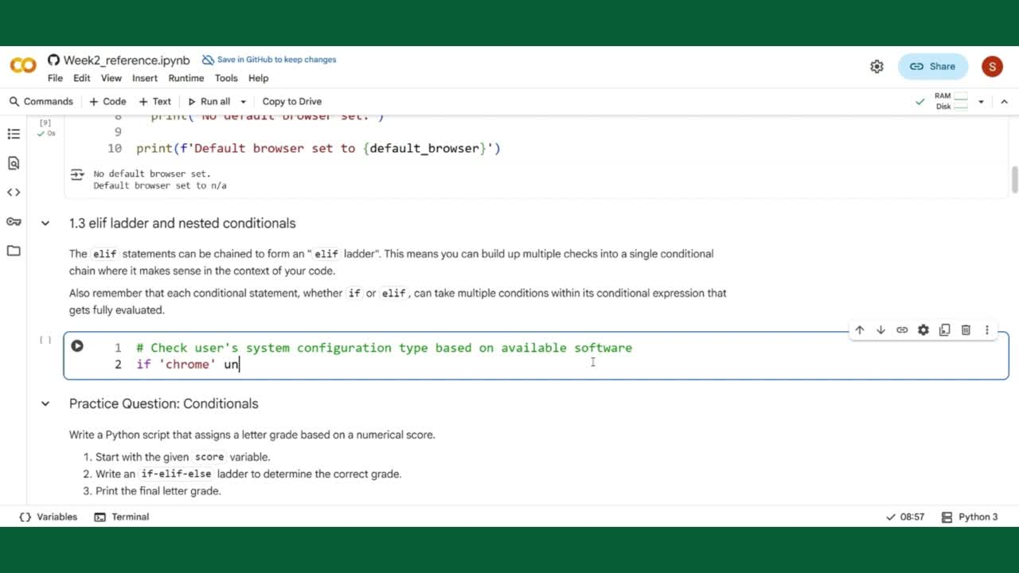

Slide 31
The match-case statement
Introduced only in Python version 3.10 (2021)
Provides a more elegant syntax for multiple pattern matching over elif ladders.
Match Subject
Case Pattern 1
True
False
Do something
Case Pattern 2
True
False
Do something
Default block

Slide 32
match-case statement syntax
match <SUBJECT>:
case <PATTERN_1>:
# Executes if matches pattern 1
case <PATTERN_n>:
# Executes if matches pattern n
case _:
# Default case executes if all above patterns fail to match
Demo: https://peps.python.org/pep-0636/

Slide 33
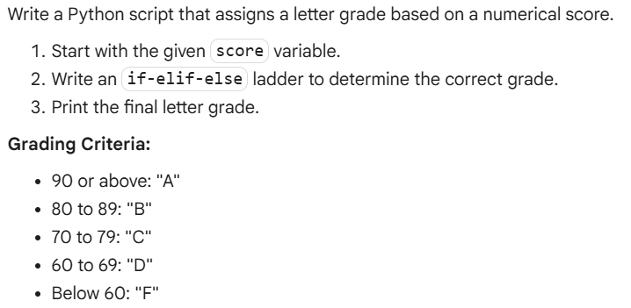
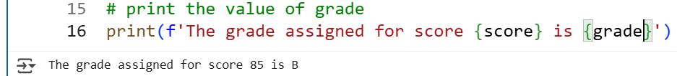
Practice Question
Expected output
Tip: use the elif ladder to your advantage to check conditions one by one.

Slide 34

ICT Learning Centre,
CS1-046,
CSIS Building,
University of Limerick,
http://ictlc.ul.ie/contactus
Thank you

